Slide 1
TOPIC B2:
PROGRAMMING
LESSON B2-3
PROGRAMMING CONSTRUCTS

Slide 2
AGENDA
Warm-up Question
Sequencing
If Statements
Else Statements
Else If Statements
Nested If Statements
Lab
NOTE!
Have a way to take notes and a way to write code available for this lesson

Slide 3

THE WARM UP QUESTION
Create a program that will take a word as input from the user, and output a number representing half of how many characters are in the user’s word
Then, output if the number of characters is even or not

Slide 4
THE WARM UP ANSWER
word = input("Type a word plzz: ") length = len(word) print(length/2) print("The word is even: " + str((length % 2) == 0))

Slide 5
SEQUENCING
Even if the code we have is correct, that doesn’t mean it won’t do the right thing if we don’t do it in the right order
Take a look at this code on the right
Look familiar?
What are we trying to do here?
What’s wrong with it?
a = 10 b = 5 a = b temp = a b = temp

Slide 6
IF STATEMENT
The if statement, also known as a selection structure, is a structure that allows us to execute code based on one or more conditions
The condition inside of the if is evaluated, and if it is True, the indented code below it will run
a = 10 if(a > 5): a = a - 2 print(a)

Slide 7
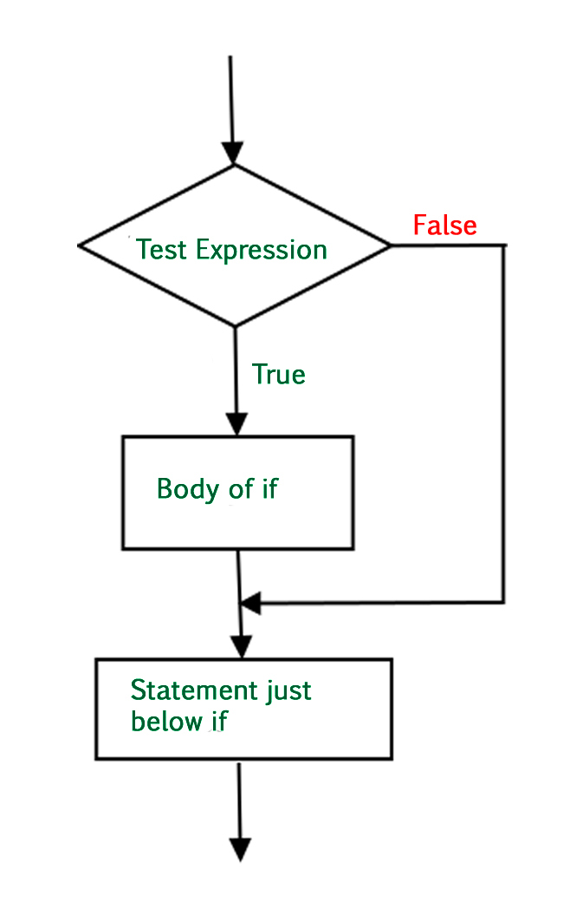
IF STATEMENT
Think of the structure in terms of a flowchart

Slide 8
IF STATEMENT
We can evaluate all sorts of expressions in the if statement
Feel free to use functions and operators as you see fit to accomplish your goals
word = input('enter a word') if(len(word) > 5): print("Word is too long man")

Slide 9
IF STATEMENT
Use and, or, & not to create complex logical conditions
name = input('enter a name') age = int(input('enter an age')) if(((age > 18 and not(name == “Jeremy")) or name=="Fritz“): print("Look at that! You can vote!")

Slide 10
IF ELSE STATEMENT
What if we want different code to execute based on if a statement is true or not?
We use the else addition to the if statement
The else will run ONLY when the condition for the if statement is NOT met
age = 17 if(age > 16): print("yeah you can drive") else: print("yeahh... you can't drive")

Slide 11
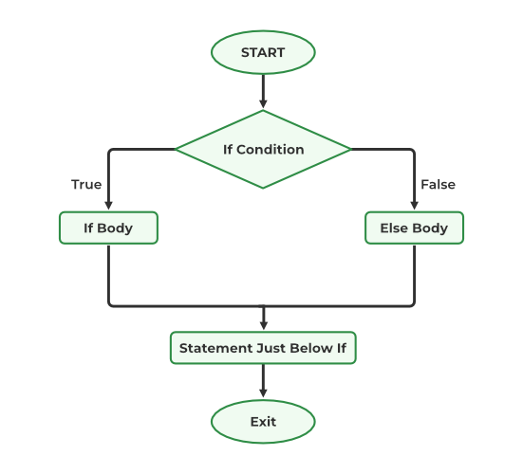
IF ELSE STATEMENT
You can also think of this in terms of a flowchart

Slide 12
PRACTICE QUESTION
Write a program that will take input for the price of an item, and discount the price by 20% if it is over $100
The program should then print out the price of that item

Slide 13
PRACTICE QUESTION
NOTE!
the eval( ) function will evaluate if the input is true or false and store it as a Boolean, use this to check membership
Let’s expand our program now. Now, if it’s over $100, and the user is a member of the store, they get a 30% discount
If they spent over $100, but the user isn’t a member, the discount remains at 30%
Using our current tools, since there are three possible outcomes, what do we need to do?

Slide 14
NESTED IF STATEMENTS
The inner if statement will only be checked if the outer one is true
This works, but can quickly spiral out of control the more conditions you need
toPay = 0 cost = float(input("Enter the price of the item: ")) member = eval(input("Do you have a membership? (true/false")) if(cost > 100): if(member == True): toPay = cost * 0.7 else: toPay = cost * 0.8 else: toPay = cost print("The price is " + str(toPay))

Slide 15
ELSE IF STATEMENT
If we want to have a conditional structure with more than two outcomes, we’ll use the else if statement, called elif in Python
elif will only be checked if the if statement above it was not true
Otherwise, these function just as the if
toPay = 0 cost = float(input("Enter the price of the item: ")) member = eval(input("Do you have a membership? (true/false")) if(cost > 100 and member == True): toPay = cost * 0.7 elif(cost > 100 and member == False): toPay = cost * 0.8 else: toPay = cost print("The price is " + str(toPay))

Slide 16
LAB
Problem 1: Write a program that asks the user for a number and a Boolean variable. If the Boolean is true, output double the number. If it is false, output the square of the number.
Problem 2: Assume the retirement age for men is 65 and women is 62. Write a program that asks the user’s age and gender to determine if they are eligible for retirement. If not, tell them how many more years they have.
Problem 3: Write a program to ask the user for two numbers and then output the larger of the two. Tell the user also if they are equal

